Slide 1
In Python, object-oriented Programming (OOPs) is a programming paradigm(set) that uses objects and classes in programming. It aims to implement real-world entities like
inheritance,
polymorphisms,
encapsulation, Abstraction etc. in the programming.
The main concept of OOPs is to bind the data and the functions that work together as a single unit.
OOPS:

Slide 2
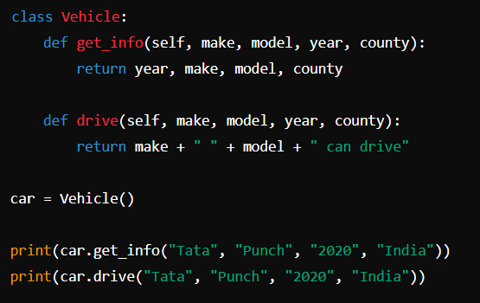
Structure of a Class
Classes: Classes are contains
methods (functions)
attributes (data, Variables)
Logical Structure or all
blueprints for creating objects.
Object:
Objects are instances of classes.
created using the class as a template.
Using object we can access the
A) Attribute(data)
b) Methods(Function) or both of a Class

Slide 3
Inheritance
The derived class(Child Class) inherits the properties of the Base class(Parent Class)
In the Inheritance Derived class(Child Class) can access all the properties (Attributes and Functions) of the Base class(Parent Class).
There are different types of Inheritance
1) Single Inheritance
2) Multilevel Inheritance
3) Multiple Inheritance

Slide 4


1) Single Inheritance

Slide 5

2) Multilevel Inheritance

Slide 6

3) Multiple Inheritance

Slide 7
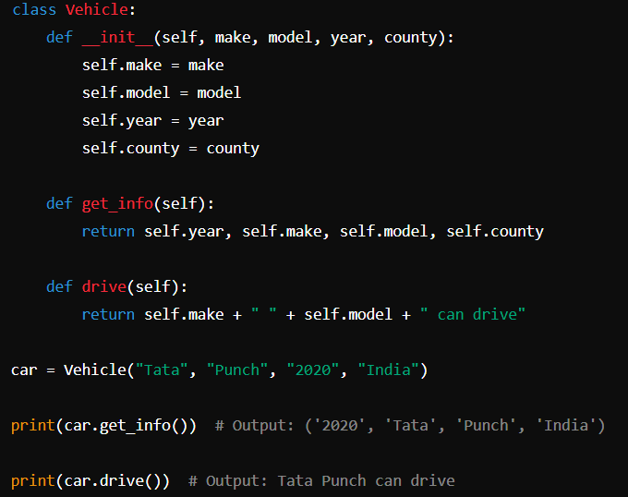
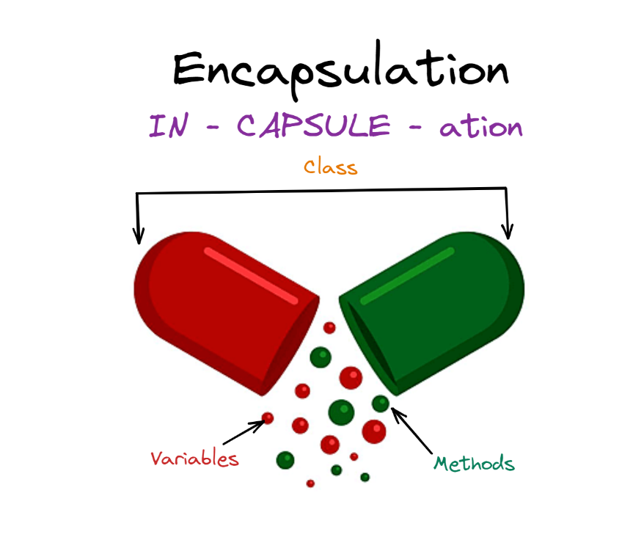
Encapsulation:

Slide 8
Poly morphism:
Polymorphism means creating multiple forms, either by passing multiple argument in a method or use of same method but with different datatype, arguments or operation.
There are two polymorphisms.
Method overloading,
Method overriding,

Slide 9
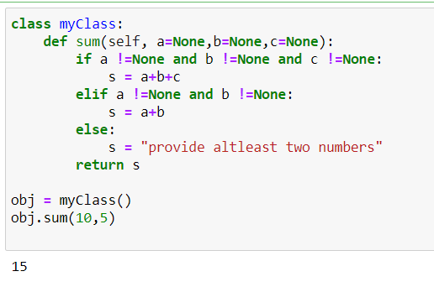
Method Overloading
If a method is written in such a way that it can perform more than one task, it is called method overloading. We can achieve method overloading by writing the same method with several parameters.

Slide 10
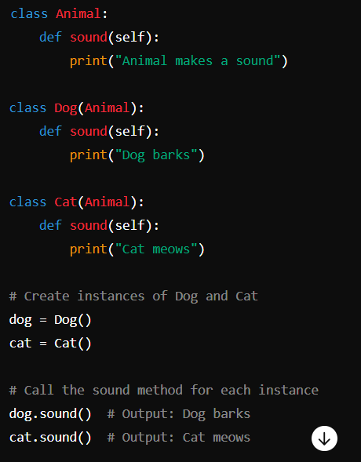
Method Overriding:
In inheritance, if we write the same method in both classes, I.e. parent class as well as child class then the parent class method is not available in the child class. In this case child class method replaces the parent class Method. Method overriding is used when the programmer wants to modify the existing behaviour of a method.

Slide 11
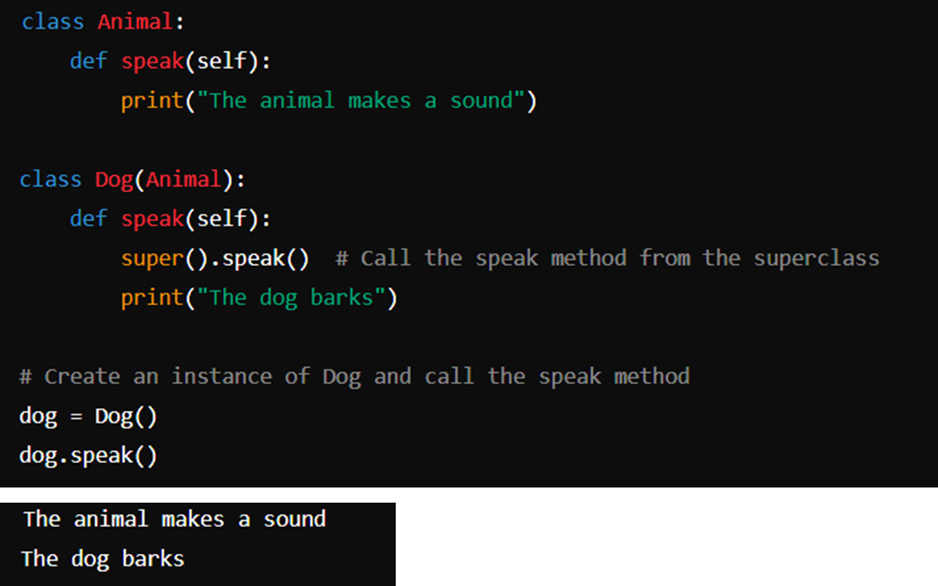
Method Overriding with super keyword:
However, if a programmer still wants to use the Parent class method then, the same can be achieved by using the “super” keyword. As shown in example two.

Slide 13
END OF OOPS

